Slide 1
Report Of The Final Project
By:
lym:518030910393 ; zkp:518030910374 ; ZWT:518030910405

Slide 2
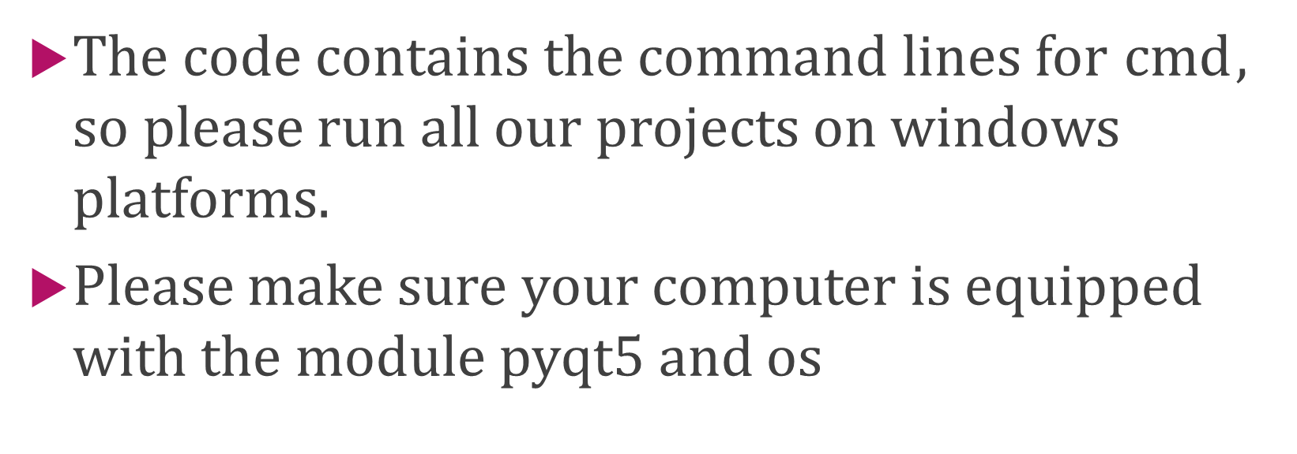
Warnings
The code contains the command lines for $cmd$, so please run all our projects on windows platforms.
Please make sure your computer is equipped with the module $pyqt5$ and $os$

Slide 3
Problem Description
Tell whether the person in the given picture is smiling.
Make the computer learn smile detection
Three subtasks:
1.Face detection
2.Smile classification
3.Realize a real-time Smile Detection application using camera

Slide 4
Problem Analysis
This is a typical classification problem. We can solve it using traditional machine learning approaches.
We use LBP to deal with the images of human faces. LBP records the contrast information between the pixel and the surrounding pixels, and describes local texture features.
We use the eigenvectors that we get from LBP as the training set to build an SVM model, a powerful binary classifier.
SVM can efficiently perform a non-linear classification using the kernel trick, mapping the input into high-dimensional feature spaces. And using kernel tricks, the calculations in high-dimensional spaces are not so complex.

Slide 5
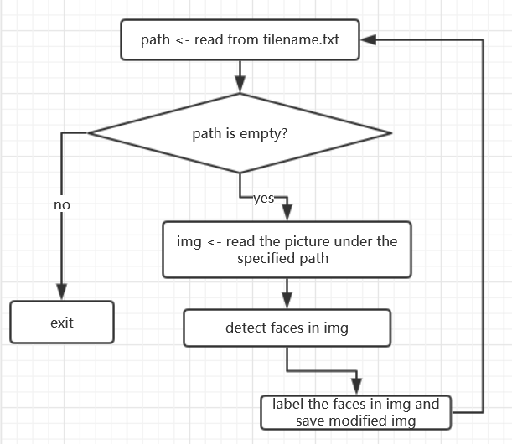
Subtask I - Face Detection
Important function:
cv2.imread()
cv2.cvtColor()
cv2.CascadeClassifier()
cv2.CascadeClassifier.detectMultiScale()
ImageDraw.Draw.rectangle()
Important resource:
haarcascade_frontalface_default.xml

Slide 6
Subtask I Note
cv2.imread(filename, flags=None):
Loads an image from the specified file and returns it.
The retval is a matrix.
(Empty matrix when the image cannot be read)
cv2.cvtColor(src, code):
Param src --- input image;
Param code --- color space conversion code
Here we use cv2.COLOR_BGR2GRAY as the
conversion code to transform the BGR mode into the
Gray mode.
And we judge the mode by the image’s dimension.
When dim=2, it’s gray image; when dim=3, it’s BGR.
cv2.CascadeClassifier.detectMultiScale():
This function is used to detect the face. It
invokes the classifier haarcascade_frontal-
face_default.xml. And the retval is a list of
ordered pairs (x,y,w,h). Each pair in the list
shows a rectangle area whose top left
corner is (x,y) , width is w and height is h.
Then for each rectangle area we get from
the function above, we draw it on the
image, and the face area in the image is
labeled.

Slide 7
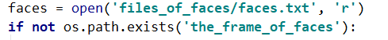
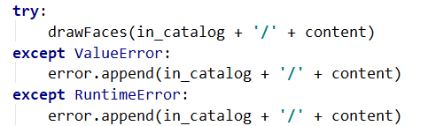
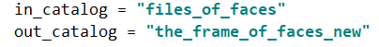
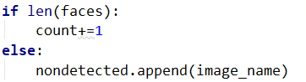
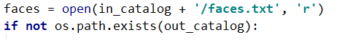
Subtask I Code Changes
Some addition
For robustness. When the image cannot be read or there are some other mistakes, we can continue to detect the remains.
For readability. The paths above appears more than once in the code. So replace the string with variables, making it convenient to modify the input and output path.
Record images of faces that we didn't detect.

Slide 8
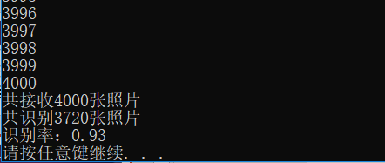
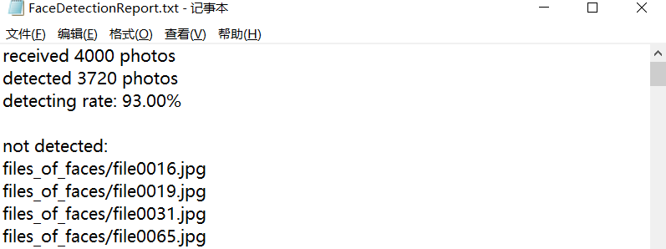
Subtask I - Running Result
The second parameter of the function below is quite significant.
When it is 1.2 the recognition rate is relatively high.
When it is 1.1, the recognition rate is even higher, but some regions without faces are considered as face regions.
Screenshot of console
Screenshot of the report file

Slide 9
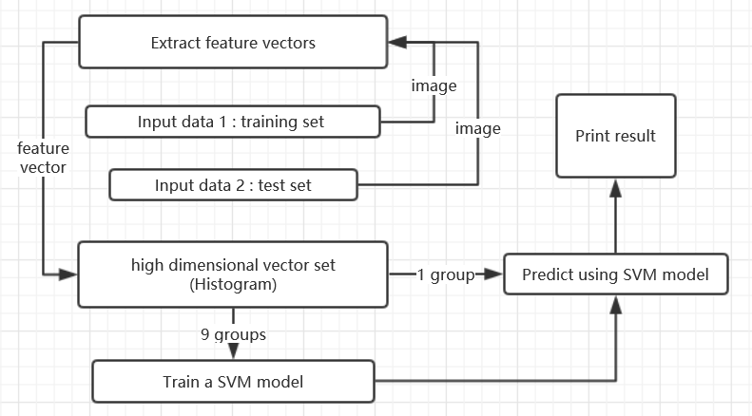
Subtask II – Smile Detection
Important library:
cv2
numpy
sklearn.svm
skimage.feature
Important function:
SVC()
numpy.vstack()
local_binary_pattern()
skimage.feature.hog()

Slide 10

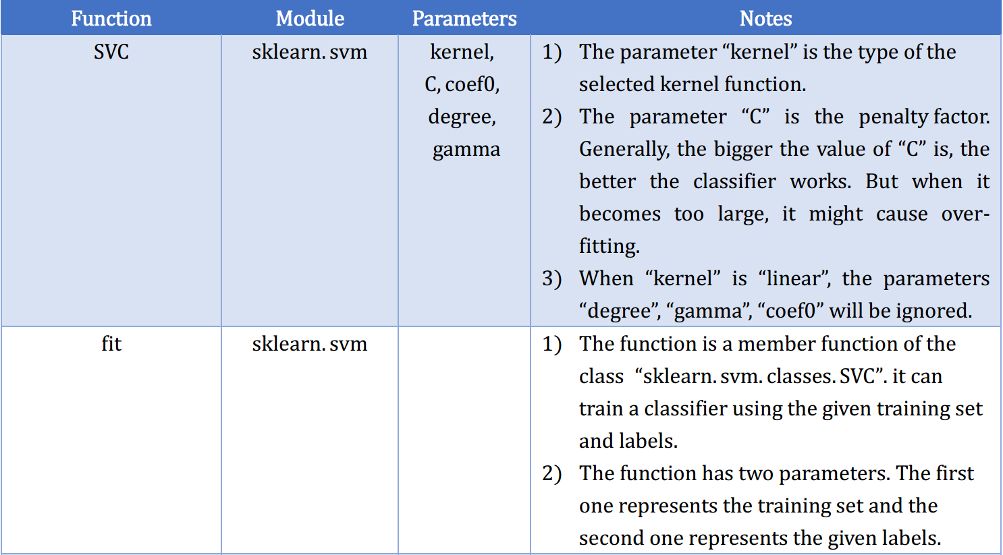
Subtask II - Note

Slide 11
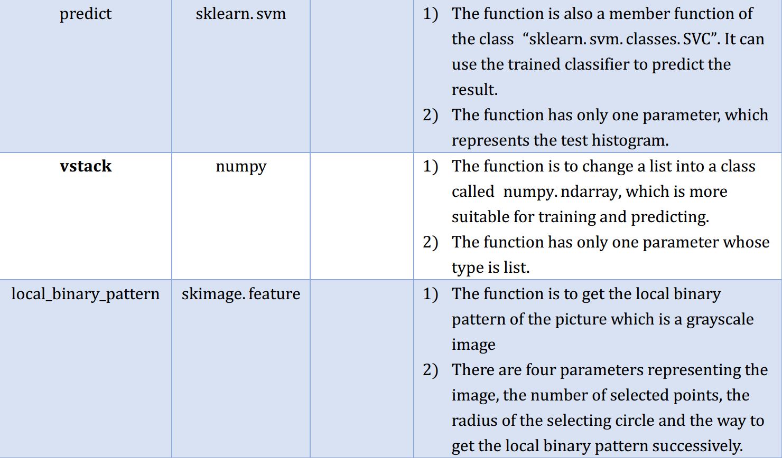
Subtask II - Note

Slide 12
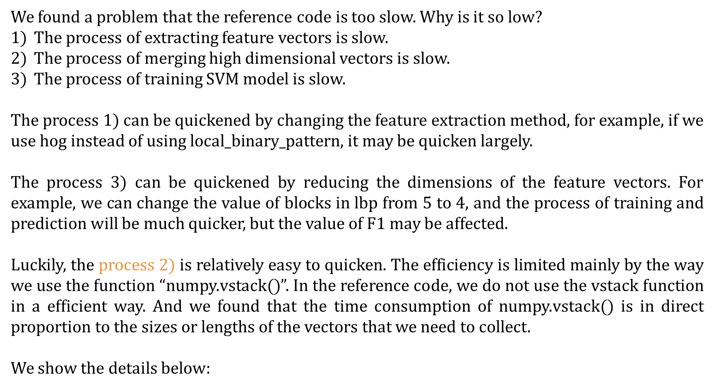
Subtask II – The Efficiency Analysis
We found a problem that the reference code is too slow. Why is it so low?
The process of extracting feature vectors is slow.
The process of merging high dimensional vectors is slow.
The process of training SVM model is slow.
The process 1) can be quickened by changing the feature extraction method, for example, if we use hog instead of using $local_binary_pattern$, it may be quicken largely.
The process 3) can be quickened by reducing the dimensions of the feature vectors. For example, we can change the value of blocks in $lbp$ from 5 to 4, and the process of training and prediction will be much quicker, but the value of F1 may be affected.
Luckily, the process 2) is relatively easy to quicken. The efficiency is limited mainly by the way we use the function “numpy.vstack()”. In the reference code, we do not use the vstack function in a efficient way. And we found that the time consumption of numpy.vstack() is in direct proportion to the sizes or lengths of the vectors that we need to collect.
We show the details below:

Slide 13
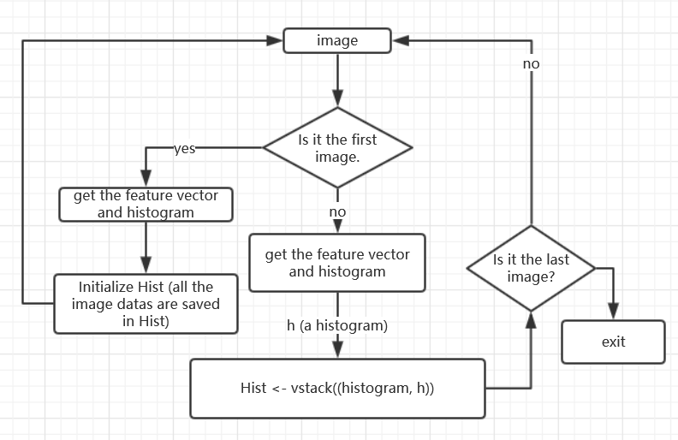
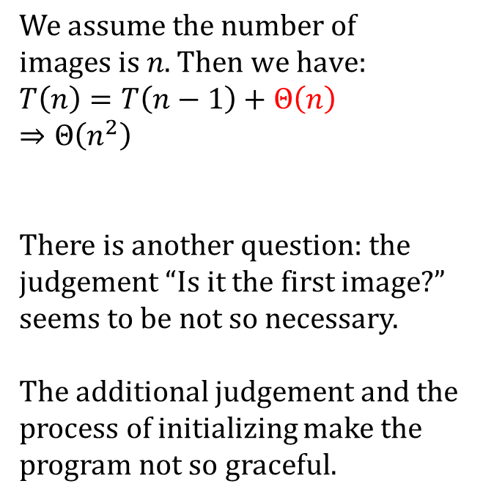
Subtask II – The Efficiency Analysis
the old version used by the reference code
$$We assume the number of$$
$images is n.$ $Then we have:$
$$T\left(n\right)=T\left(n−1\right)+Θ\left(n\right)$$
$⇒Θ\left(n^{2}\right)$
There is another question: the judgement “Is it the first image?” seems to be not so necessary.
The additional judgement and the process of initializing make the program not so graceful.
The image datas are collected in “Hist”.

Slide 14
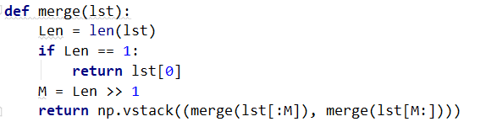
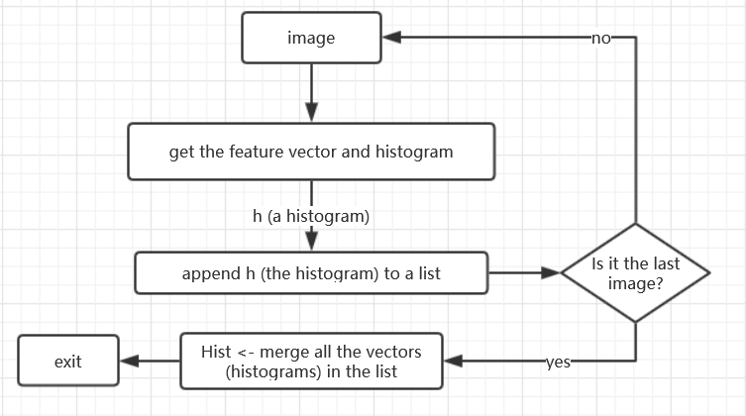
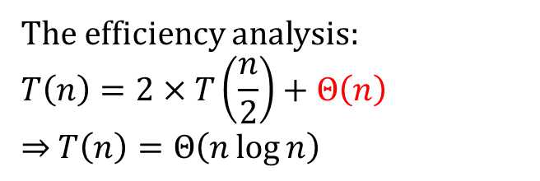
Subtask II – The Efficiency Analysis
The code of the function “merge”
the improved version used by the our code
The efficiency analysis:
$$T\left(n\right)=2×T\left(\frac{n}{2}\right)+Θ\left(n\right)$$
$⇒$ $T\left(n\right)=Θ\left(n\log{n}\right)$
The process of “merge” is similar to “merge sort” in some degree.
And in this version, the code is more concise and more efficient.
The robustness is surprisingly good.
The image data set is collected in “Hist”.

Slide 15
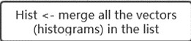
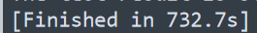
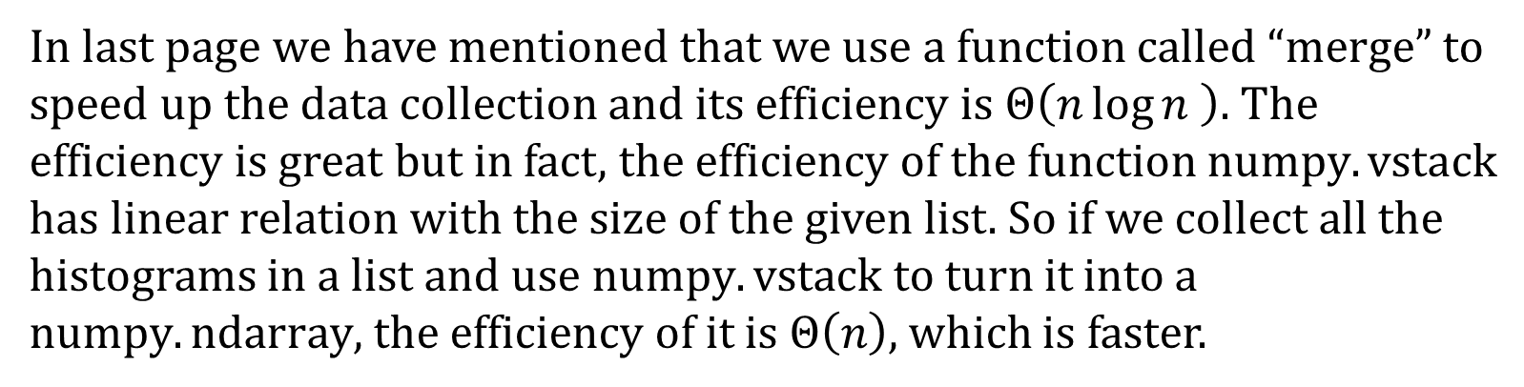
Subtask II – The Efficiency Analysis
In last page we have mentioned that we use a function called “merge” to speed up the data collection and its efficiency is $Θ\left(n\log{n} \right)$. The efficiency is great but in fact, the efficiency of the function $numpy.vstack$ has linear relation with the size of the given list. So if we collect all the histograms in a list and use $numpy.vstack$ to turn it into a $numpy.ndarray$, the efficiency of it is $Θ\left(n\right)$, which is faster.
Version II:
Version III:
The two pictures on the right is the time consuming of two versions, but we may find that there is no significant difference.

Slide 16
Subtask II – Parameter Adjustment
We use local-binary-pattern to extract the feature vectors. We calculate the different values of F1 when the parameter blocks changes. (The blocks means how many blocks we divide the image into.) The datas are shown below:
blocks = 3 | blocks = 4 | blocks = 5 | blocks = 6
group 0, F1: 0.828375 | group 0, F1: 0.853012 | group 0, F1: 0.872549 | group 0, F1: 0.855769
group 1, F1: 0.813559 | group 1, F1: 0.855746 | group 1, F1: 0.882793 | group 1, F1: 0.892768
group 2, F1: 0.848921 | group 2, F1: 0.875598 | group 2, F1: 0.876238 | group 2, F1: 0.904523
group 3, F1: 0.803738 | group 3, F1: 0.853081 | group 3, F1: 0.836272 | group 3, F1: 0.849383
group 4, F1: 0.858491 | group 4, F1: 0.893720 | group 4, F1: 0.884058 | group 4, F1: 0.897059
group 5, F1: 0.864486 | group 5, F1: 0.874109 | group 5, F1: 0.905569 | group 5, F1: 0.910843
group 6, F1: 0.838407 | group 6, F1: 0.891509 | group 6, F1: 0.883495 | group 6, F1: 0.898058
group 7, F1: 0.864608 | group 7, F1: 0.906921 | group 7, F1: 0.889952 | group 7, F1: 0.901205
group 8, F1: 0.838554 | group 8, F1: 0.882927 | group 8, F1: 0.888350 | group 8, F1: 0.888889
group 9, F1: 0.825553 | group 9, F1: 0.870416 | group 9, F1: 0.891139 | group 9, F1: 0.878788
blocks = 6 is relatively good, but the dimension of the vector is higher, and the process of training and prediction is slower

Slide 17
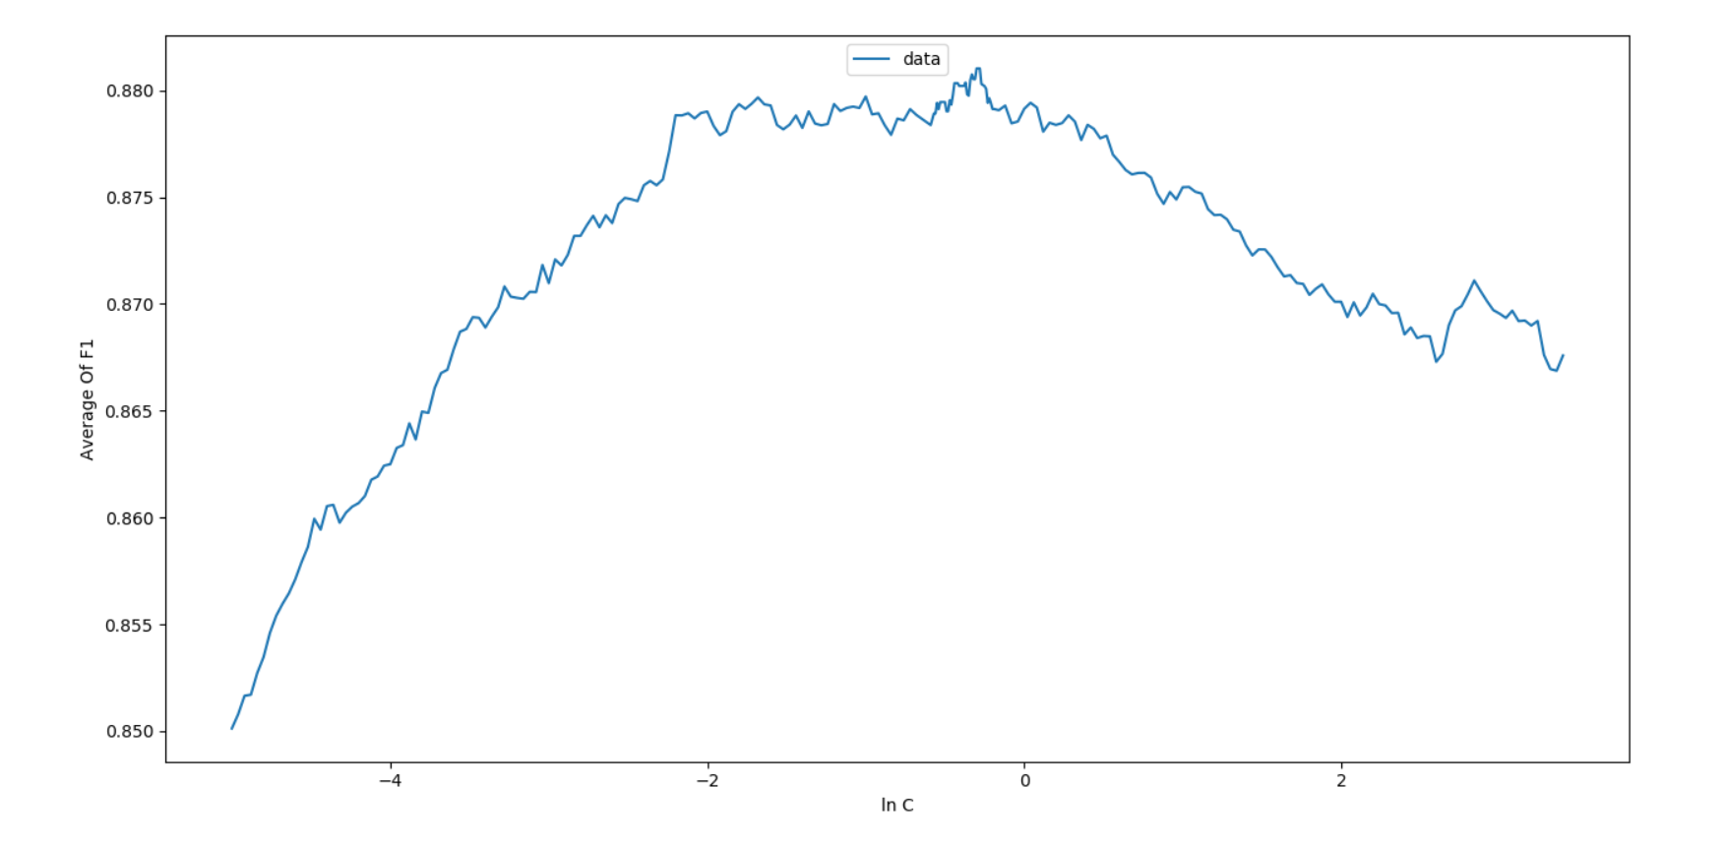
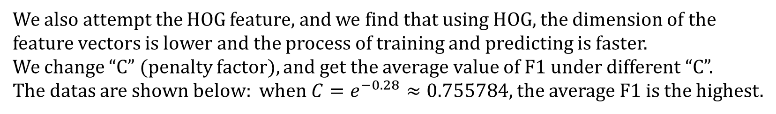
Subtask II – Parameter Adjustment
We also attempt the HOG feature, and we find that using HOG, the dimension of the feature vectors is lower and the process of training and predicting is faster.
We change “C” (penalty factor), and get the average value of F1 under different “C”.
The datas are shown below: when $C=e^{−0.28}≈0.755784,$ the average F1 is the highest.

Slide 18
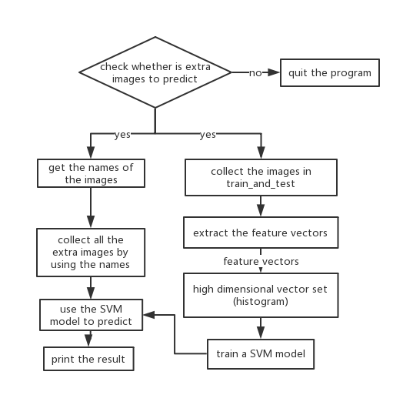
Subtask II – Additional function
We may find a interesting thing that the program can collect feature vectors from the given pictures, so we can use the collected feature vectors to train the classifier and used the classifier to predict whether a image is a smiling face. Then we have an additional function which can predict your own images. The picture on the right is the progress of the additional function.

Slide 19
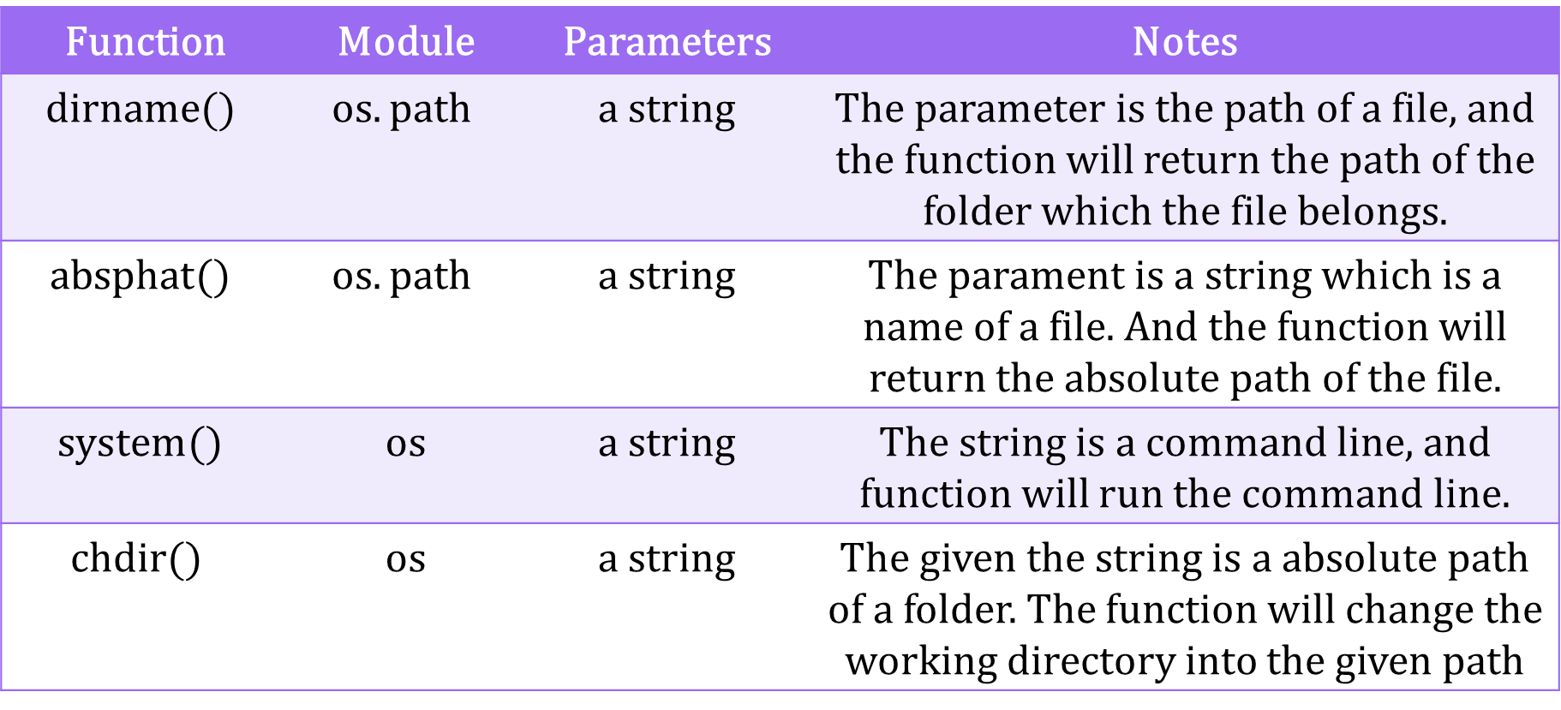
Subtask II – Notes of Additional function
To realize the function, we might need the following functions
Function | Module | Parameters | Notes
$$dirname()$$ | $$os.path$$ | a string | The parameter is the path of a file, and the function will return the path of the folder which the file belongs.
$$absphat()$$ | $$os.path$$ | a string | The parament is a string which is a name of a file. And the function will return the absolute path of the file.
$$system()$$ | os | a string | The string is a command line, and function will run the command line.
$$chdir()$$ | os | a string | The given the string is a absolute path of a folder. The function will change the working directory into the given path

Slide 20
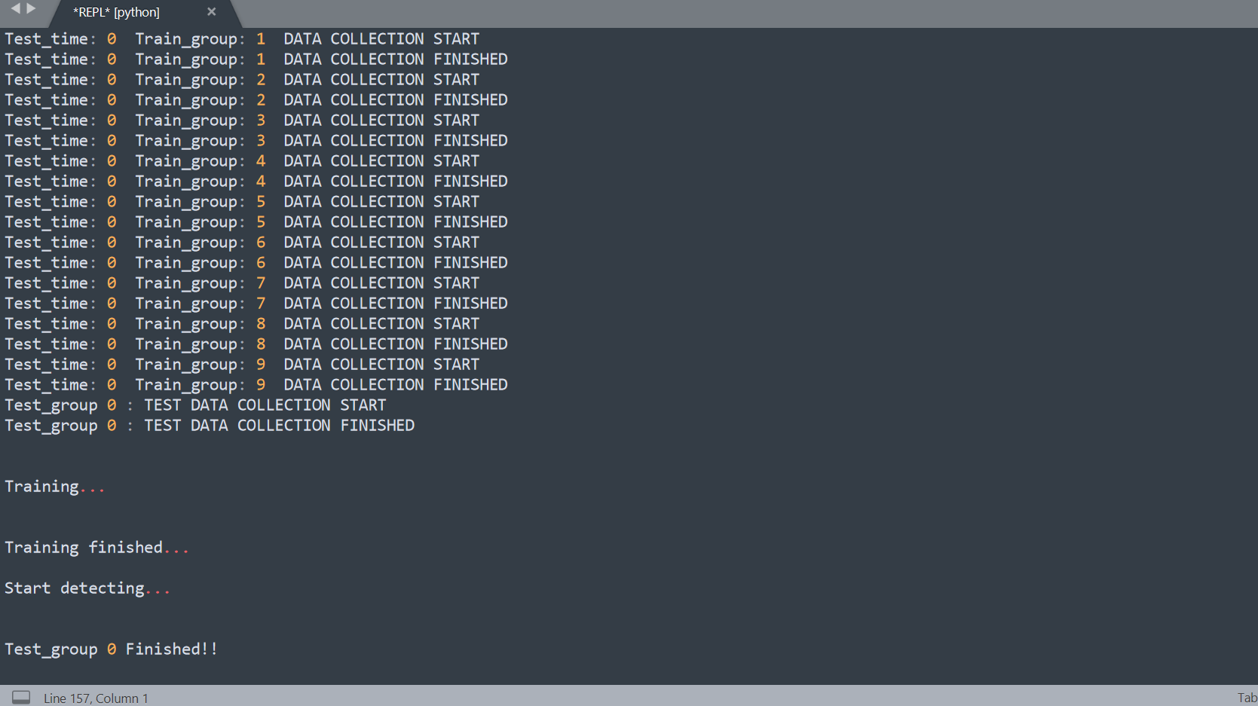
Subtask II – Running Result
Comparing with the original version, we have removed all the output of F1 and store then in a text file. Also, we print the running process on the screen which might make the user clear about how the program works

Slide 21
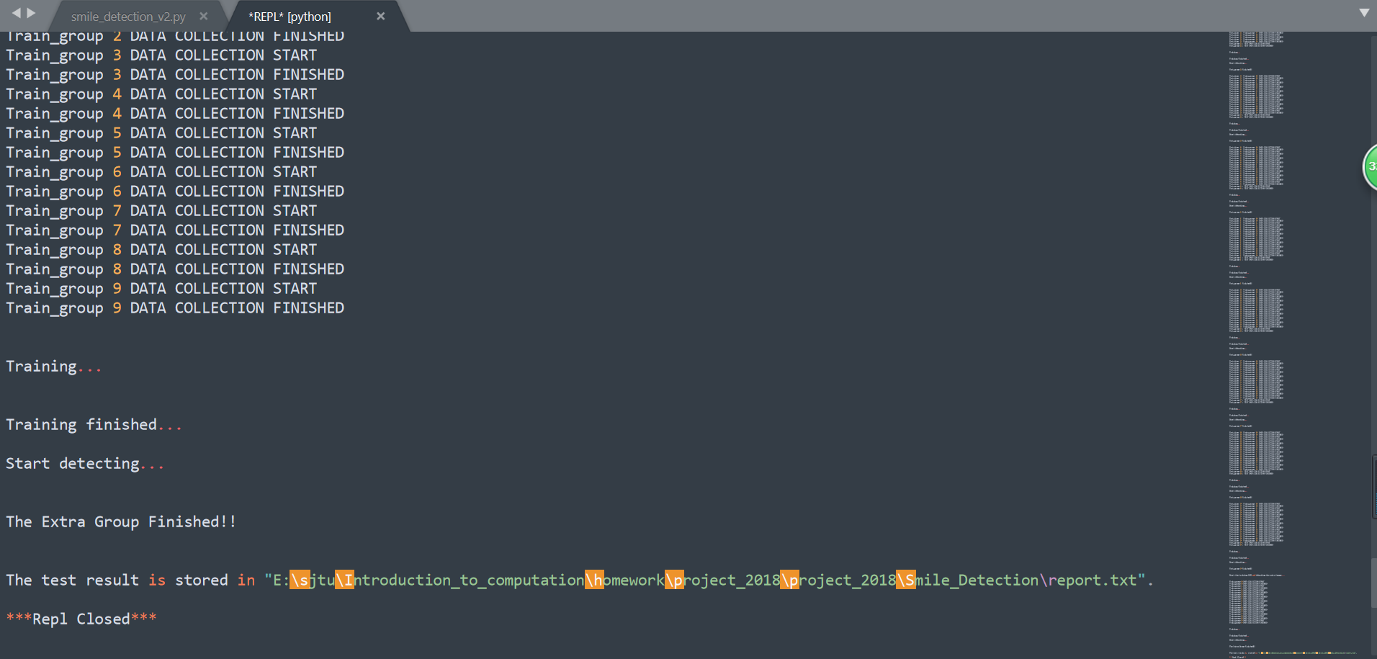
Subtask II – Running Result
And all the result is stored in a text file, instead of showing them on the screen. You might find the report by the given path.

Slide 22
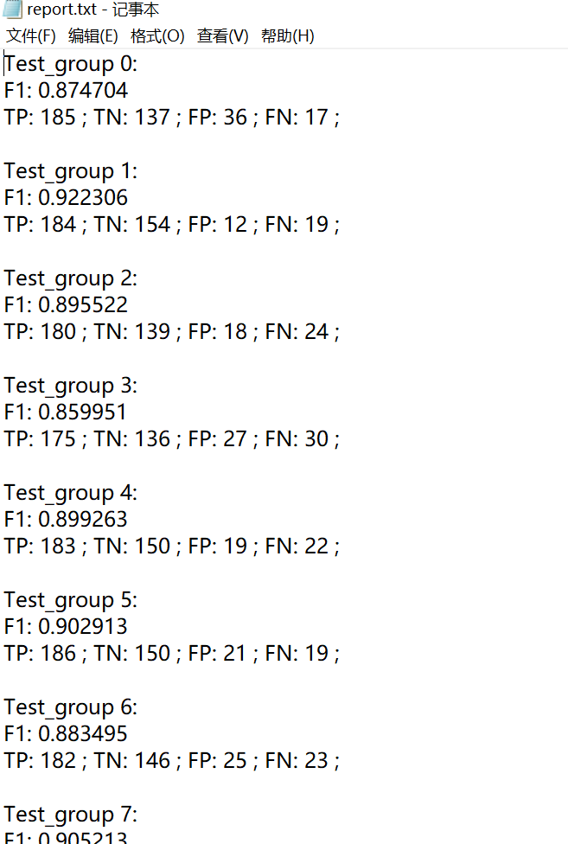
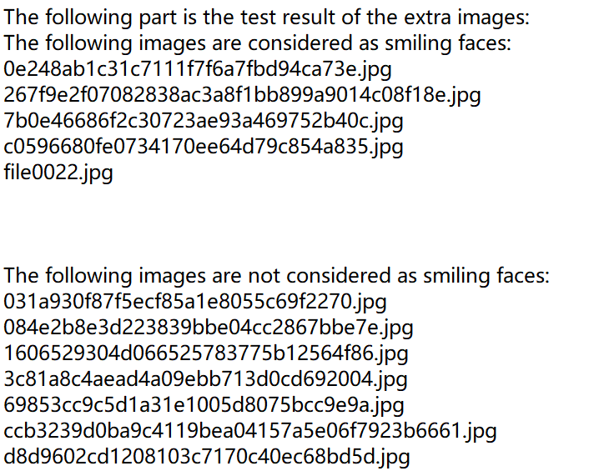
Subtask II – Running Result
The following is the report:
But in fact, the result is no good. Because the feature vector is extracted from the whole picture, not the area of faces, so it might cause lots of mistakes.

Slide 23
Subtask II – Questions and Answers
What is training dataset? What is test dataset?
Sol: training dataset is a set of data with labels, the label will be considered as a stander and help to adjust the parameters while training the SVM. The test dataset is also a set of data with labels. But the labels will not change the parameters of a SVM. It’s used to test the accuracy of the SVM model and the labels are just used for statistics and to value the SVM model.

Slide 24
Subtask II – Questions and Answers
What is the feature of an image?
Sol: the feature of a image represent the characteristics of the image in some respects, such as colors, Image gradient or textures. For example, to get the characteristic of texture, people use LBP. It works on the gray level image. The computer divide the image into several parts and get the LBP values of each part by comparing the values of some points in the area. Then it draw a histogram of the appearance frequency of every LBP values and get the feature vectors by concatenating the histogram.

Slide 25
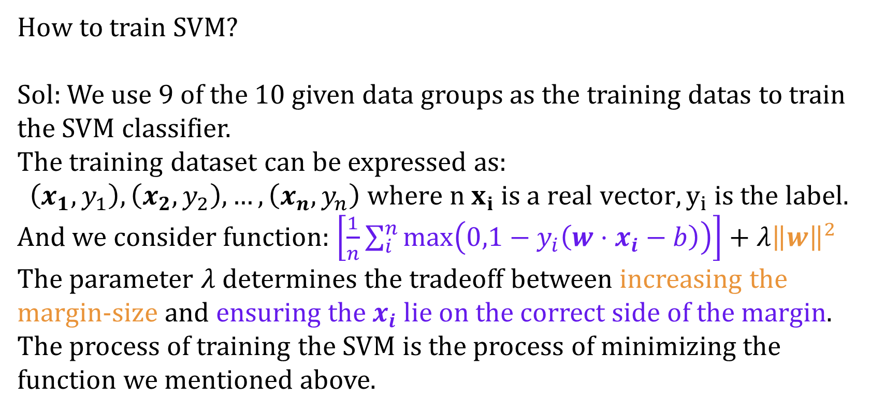
Subtask II – Questions and Answers
How to train SVM?
Sol: We use 9 of the 10 given data groups as the training datas to train the SVM classifier.
The training dataset can be expressed as:
$\left(x_{1},y_{1}\right),\left(x_{2},y_{2}\right),…,\left(x_{n},y_{n}\right) where n x_{i} is a real vector, y_{i} is the label.$
And we consider function: $\left[\frac{1}{n}\sum_{i}^{n}{\max\left(0,1−y_{i}\left(w⋅x_{i}−b\right)\right)}\right]+λ{\left\|w\right\|}^{2}$
The parameter $λ$ determines the tradeoff between increasing the margin-size and ensuring the $x_{i}$ lie on the correct side of the margin.
The process of training the SVM is the process of minimizing the function we mentioned above.

Slide 26
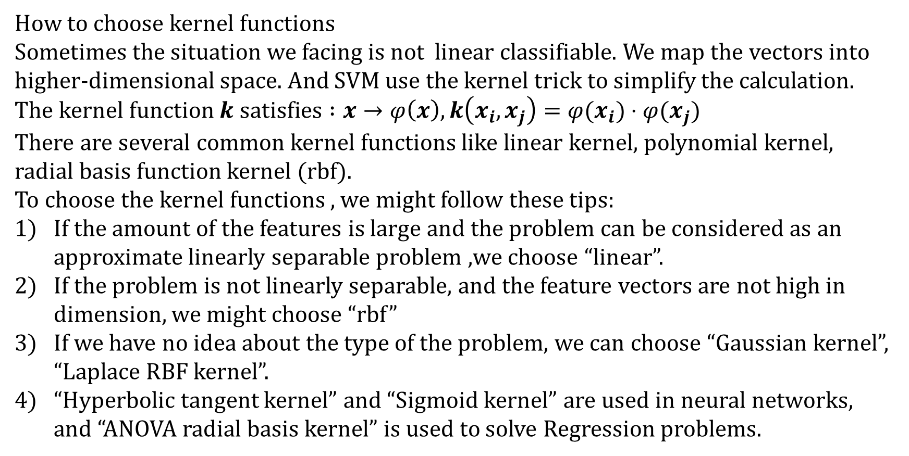
Subtask II – Questions and Answers
How to choose kernel functions
Sometimes the situation we facing is not linear classifiable. We map the vectors into higher-dimensional space. And SVM use the kernel trick to simplify the calculation.
The kernel function $k satisfies :x→φ\left(x\right), k\left(x_{i},x_{j}\right)=φ(x_{i})⋅φ(x_{j})$
There are several common kernel functions like linear kernel, polynomial kernel, radial basis function kernel (rbf).
To choose the kernel functions , we might follow these tips:
If the amount of the features is large and the problem can be considered as an approximate linearly separable problem ,we choose “linear”.
If the problem is not linearly separable, and the feature vectors are not high in dimension, we might choose “rbf”
If we have no idea about the type of the problem, we can choose “Gaussian kernel”, “Laplace RBF kernel”.
“Hyperbolic tangent kernel” and “Sigmoid kernel” are used in neural networks, and “ANOVA radial basis kernel” is used to solve Regression problems.

Slide 27
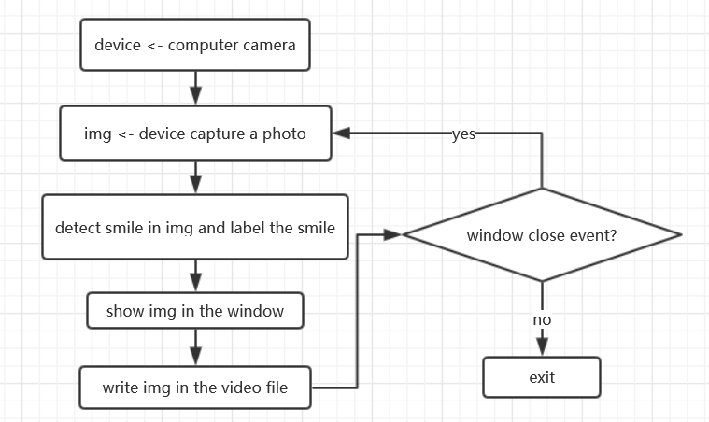
Subtask III - Real-time Detection
Important library:
cv2
Important function:
cv2.VideoCapture()
cv2.VideoWriter()
cv2.imread()
cv2.imshow()
cv2.waitKey()
Important resource:
haarcascade_smile.xml

Slide 28
Subtask III Note
cv2.VideoCapture(para1):
When para1 is 0, it invokes the built-in camera.
When para1 is a path of a video file, it invokes the file.
cv2.imshow(para1,para2):
para1(a string):Name of the window.
para2(a matrix):Image to be show.
It will show the specified image in the assigned window.
This function should be followed by cv2.waitKey().
Otherwise, it won’t display the image.
cv2.waitKey(para):
When pata is 0, it will display the image infinitely until pressing a key.
When pata is greater than 0, it will display the image for para ms,
after which the display will be automatically closed.
If we put this function into a loop, we can show the video frame-by-frame.
The retval of cv2.waitKey():
When we do not press any key, it returns -1 (or we can consider it as 255, the complement code of -1)
When we press a key, it returns the ASCII code
(0~255).

Slide 29
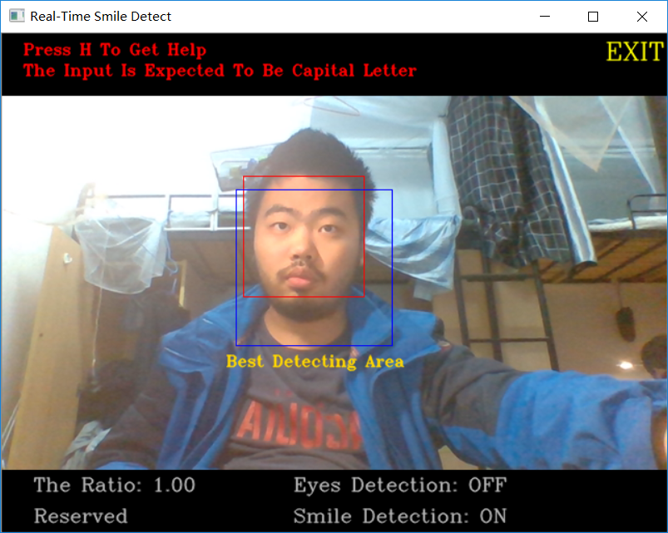
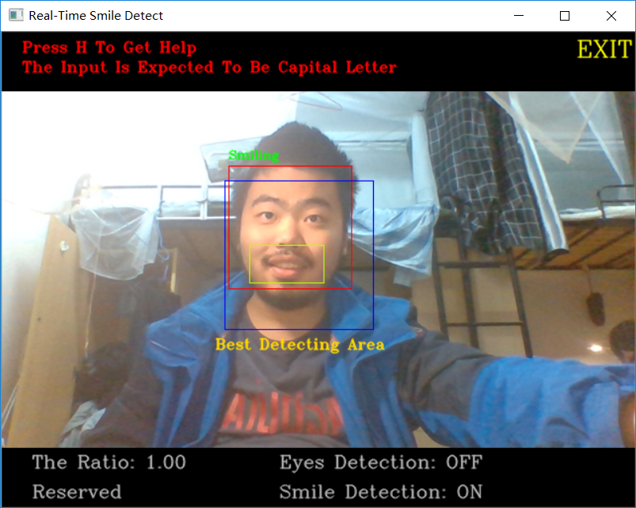
Subtask III – Real-time Detection(1)
source file

Slide 30
Subtask III – Code Changes
We made some small changes on the basis of the reference code:
We changed the video format from .mp4 to .avi, and changed MP4V into XVID correspondingly, just to avoid the warnings reported by the interpreter.
We added a line of codes “out.release()” at the end of the code. Just to avoid such situation that we cannot delete or invoke the output file “output.avi” after running the real-time detection script.
We added a function to detect eyes. And it can be switched on/off by pressing ‘E’.
We added a function to scale the image. We realize this function by cv2.warpAffine() using the transfer matrix.
We added a function to reverse the image, making our camera more similar to a mirror, and bringing better using experiences to users.

Slide 31
Subtask III – Some Problems For Version1
The program cannot be stopped by clicking the quit botton. It can only be closed by pressing keys.
We can use “mouse_event” offered by cv2 to receive the message sent by the mouse.
And we can set an area in the window. When the user click this area, the program ends.
But there is still a problem, when we click the outside edge of the window, the “mouse_event” will not be triggered.
So we come up with an idea: we can use “pyqt5”.

Slide 32
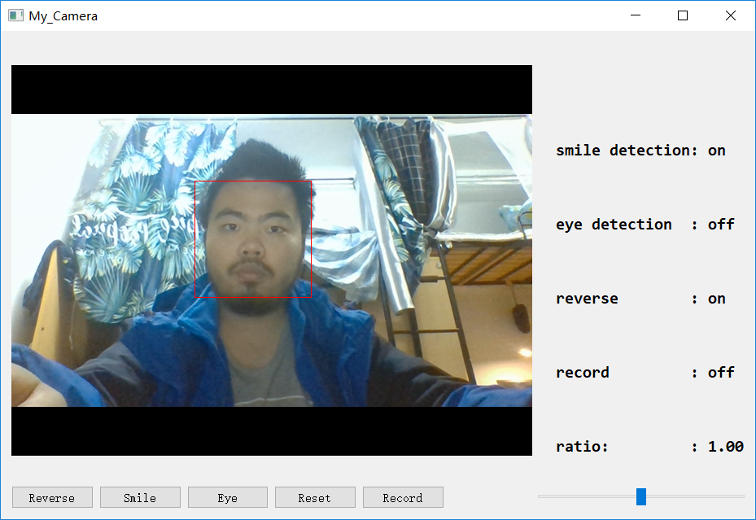
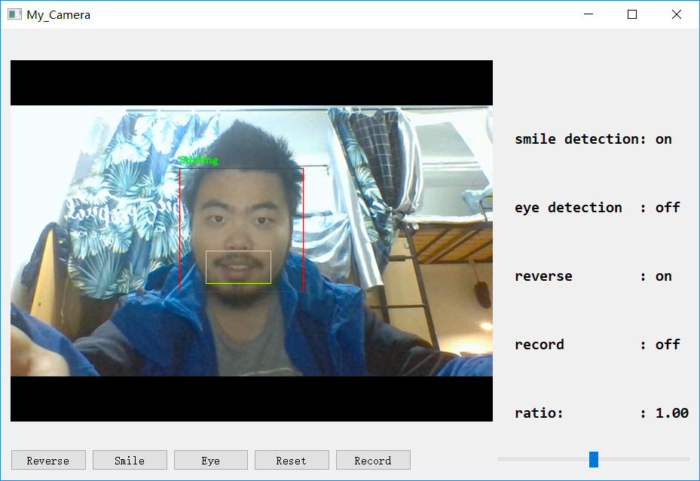
Subtask III – Real-time Detection(2)
source file
In this version, the interface is more friendly, and more pleasant to see.
And we can click the botton instead of pressing keys.

Slide 33
Subtask III – Version2
Function(or Improvement) | Realize(codes and details)
Click the cross to quit | Use the pyqt5 widget
Elegant window layout | Use the grid layout to design
Switch on/off functions by clicking buttons | Use Qt’s signals and slots
Inquire whether save the video or not when quitting | Rewrite the close_event, and use the QMessageBox
Scale the image and reverse the image | Use transfer matrix. Use cv2.warpAffine() and cv2.flip()
Improve the accuracy rate of smile detection | Adjust the parameters. Change the fixed minimum detecting size into a variable which changes with the size of detected faces.

